Slide 1
Neural networks

Slide 2
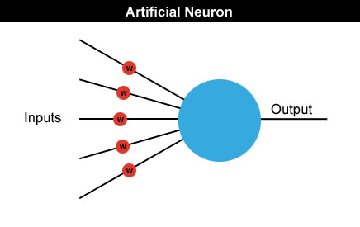
Neural networks
Neural networks are made up of many artificial neurons.
Each input into the neuron has its own weight associated with it illustrated by the red circle.
A weight is simply a floating point number and it's these we adjust when we eventually come to train the network.

Slide 3
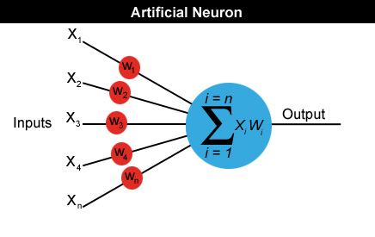
Neural networks
A neuron can have any number of inputs from one to n, where n is the total number of inputs.
The inputs may be represented therefore as x1, x2, x3… xn.
And the corresponding weights for the inputs as w1, w2, w3… wn.
Output a = x1w1+x2w2+x3w3... +xnwn

Slide 4
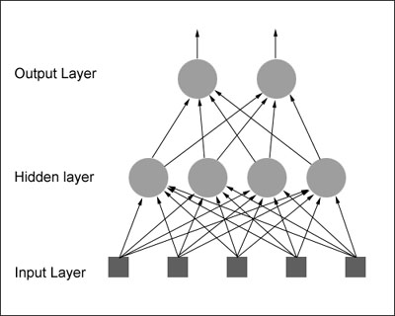
How do we actually use an artificial neuron?
feedforward network: The neurons in each layer feed their output forward to the next layer until we get the final output from the neural network.
There can be any number of hidden layers within a feedforward network.
The number of neurons can be completely arbitrary.

Slide 5
Neural Networks by an Example
initialize the neural net with random weights
feed it a series of inputs which represent, in this example, the different panel configurations
For each configuration we check to see what its output is and adjust the weights accordingly.

Slide 6
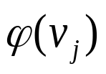
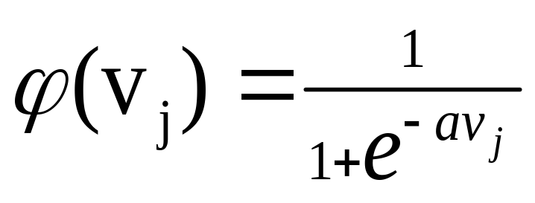

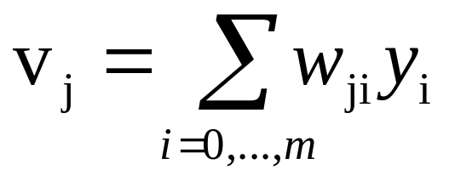

NEURON MODEL
Sigmoidal Function
induced field of neuron j
Most common form of activation function
a →∞ ⇒ ϕ → threshold functiontiable
1
Increasing a
-10 -8 -6 -4 -2 2 4 6 8 10

Slide 7
Multi-Layer Perceptron (MLP)

Slide 8
x₁
x_{n}
We will introduce the MLP and the backpropagation algorithm which is used to train it
MLP used to describe any general feedforward (no recurrent connections) network
However, we will concentrate on nets with units arranged in layers

Slide 9
x₁
x_{n}
NB different books refer to the above as either 4 layer (no. of layers of neurons) or 3 layer (no. of layers of adaptive weights). We will follow the latter convention
1st question:
what do the extra layers gain you? Start with looking at what a single layer can’t do

Slide 10
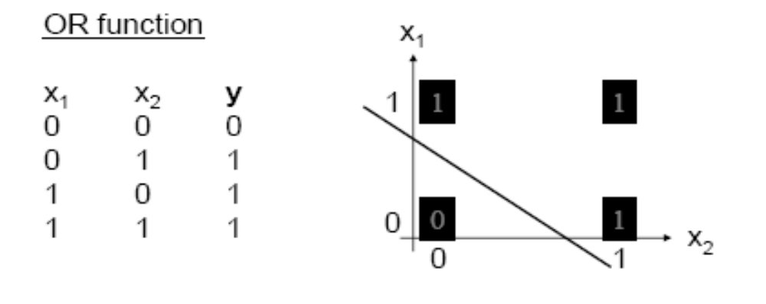
Perceptron Learning Theorem
Recap: A perceptron (threshold unit) can learn anything that it can represent (i.e. anything separable with a hyperplane)

Slide 11
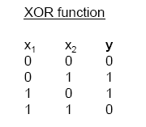
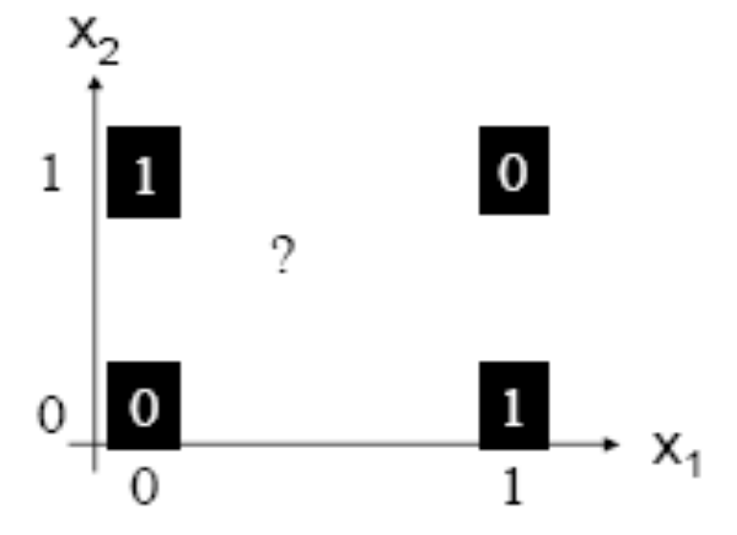
The Exclusive OR problem
A Perceptron cannot represent Exclusive OR since it is not linearly separable.

Slide 12
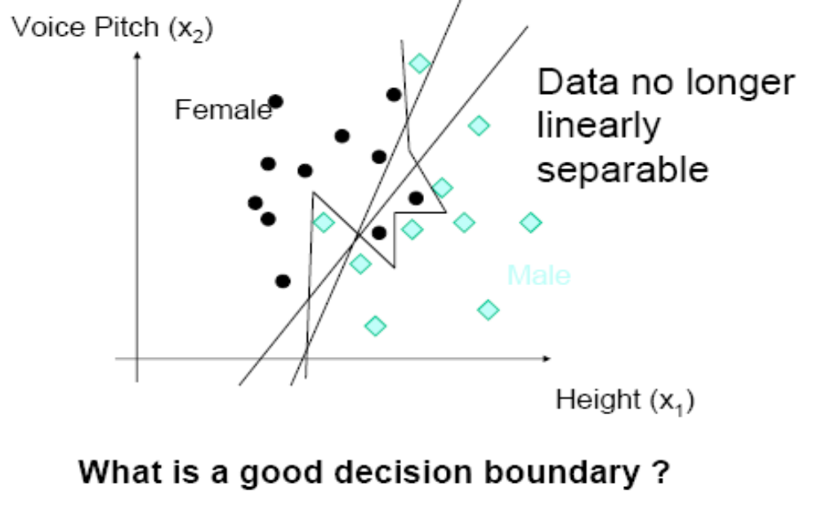

Slide 13
Minsky & Papert (1969) offered solution to XOR problem by
combining perceptron unit responses using a second layer of
Units. Piecewise linear classification using an MLP with
threshold (perceptron) units
+1
1
3
2
+1

Slide 14
Three-layer networks
x₁
x₂
Input
Output
x_{n}
Hidden layers

Slide 15
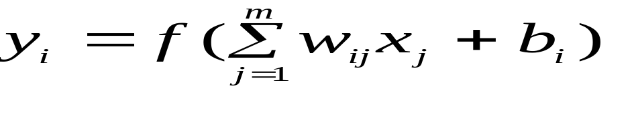
Properties of architecture
No connections within a layer
Each unit is a perceptron

Slide 16
Properties of architecture
No connections within a layer
No direct connections between input and output layers
Each unit is a perceptron

Slide 17
Properties of architecture
No connections within a layer
No direct connections between input and output layers
Fully connected between layers
Each unit is a perceptron

Slide 18
Properties of architecture
No connections within a layer
No direct connections between input and output layers
Fully connected between layers
Often more than 3 layers
Number of output units need not equal number of input units
Number of hidden units per layer can be more or less than
input or output units
Each unit is a perceptron
Often include bias as an extra weight

Slide 19
What do each of the layers do?
3rd layer can generate arbitrarily complex boundaries
1st layer draws linear boundaries
2nd layer combines the boundaries

Slide 20
Backpropagation learning algorithm ‘BP’
Solution to credit assignment problem in MLP. Rumelhart, Hinton and Williams (1986) (though actually invented earlier in a PhD thesis relating to economics)
BP has two phases:
Forward pass phase: computes ‘functional signal’, feed forward
propagation of input pattern signals through network
Backward pass phase: computes ‘error signal’, propagates
the error backwards through network starting at output units
(where the error is the difference between actual and desired
output values)

Slide 21
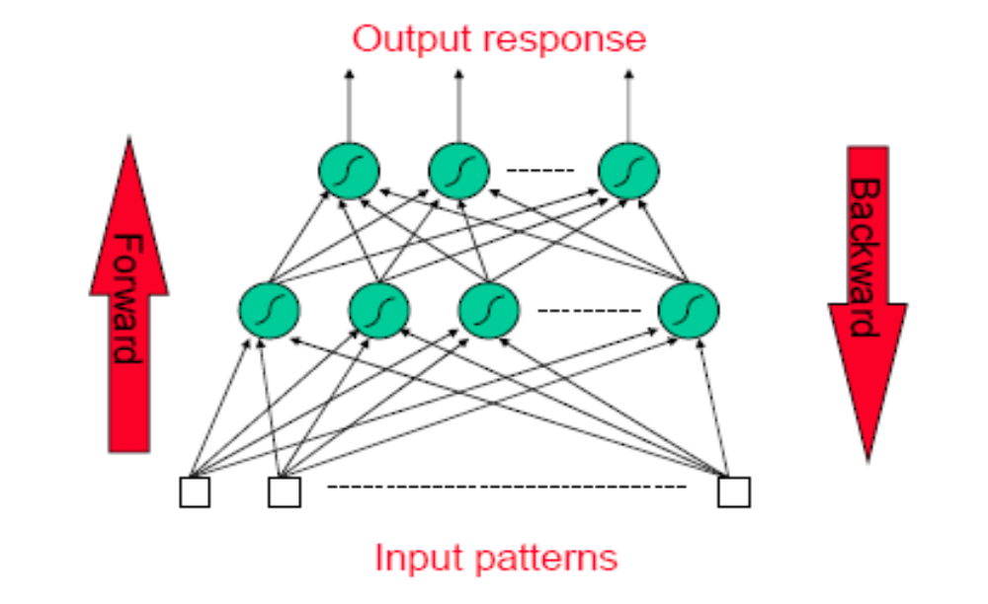
Conceptually: Forward Activity -
Backward Error

Slide 22
Forward Propagation of Activity
Step 1: Initialise weights at random, choose a learning rate η
Until network is trained:
For each training example i.e. input pattern and target output(s):
Step 2: Do forward pass through net (with fixed weights) to produce output(s)
  i.e., in Forward Direction, layer by layer:
    Inputs applied
    Multiplied by weights
    Summed
    ‘Squashed’ by sigmoid activation function
    Output passed to each neuron in next layer
  Repeat above until network output(s) produced

Slide 23
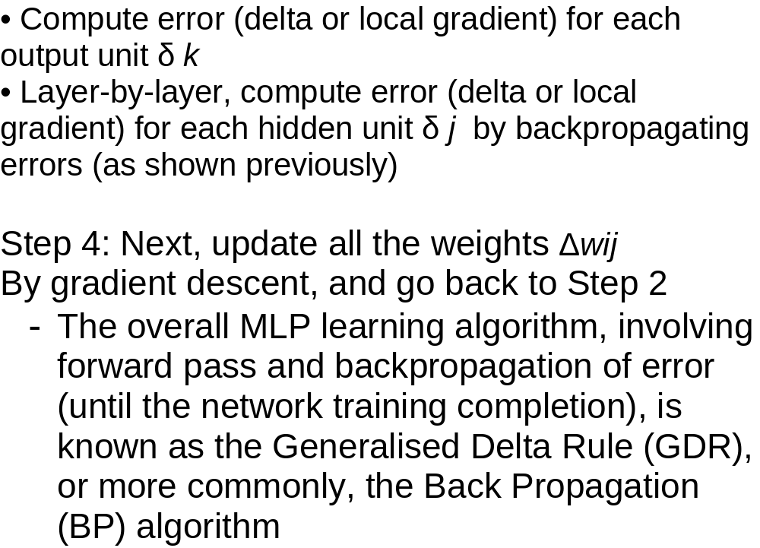
Step 3. Back-propagation of error

Slide 24
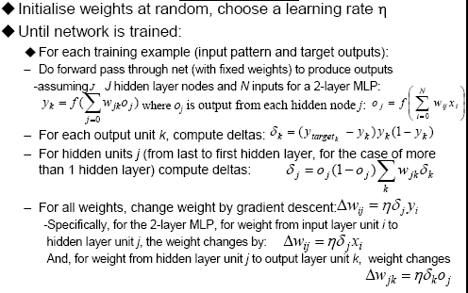
‘Back-prop’ algorithm summary

Slide 25
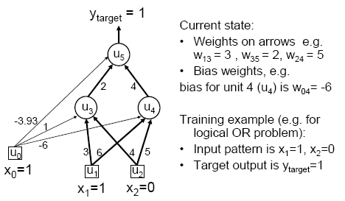
MLP/BP: A worked example

Slide 26
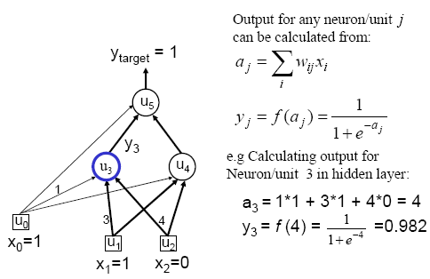
Worked example: Forward Pass

Slide 27
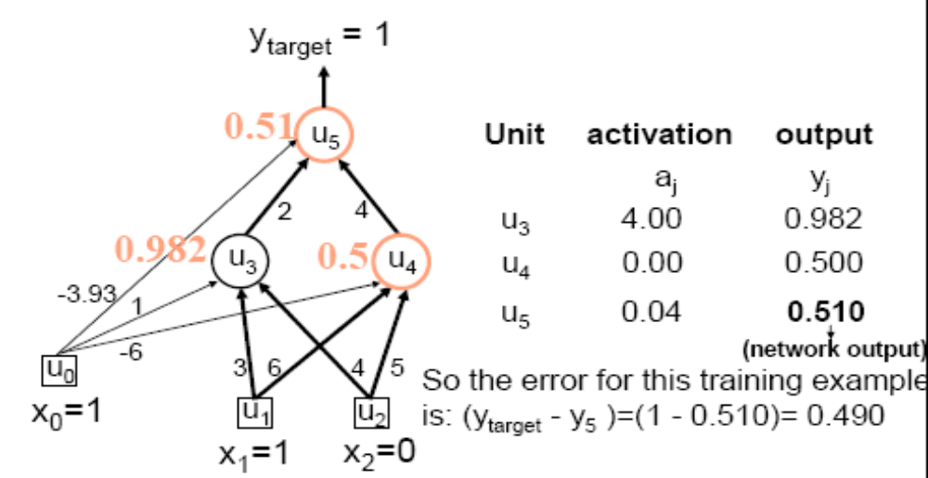
Worked example: Forward Pass

Slide 28
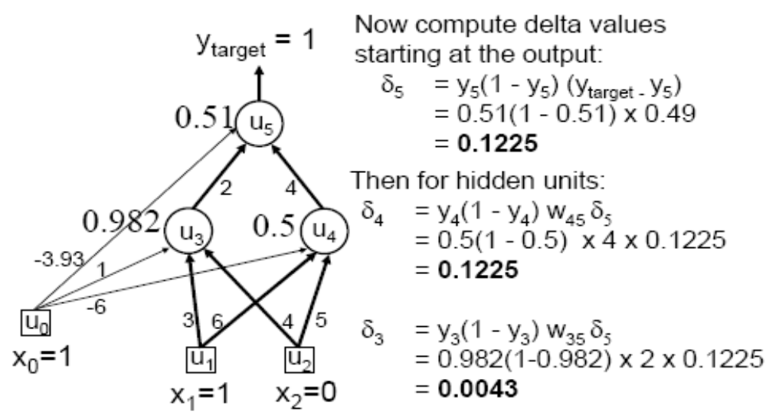
Worked example: Backward Pass

Slide 29
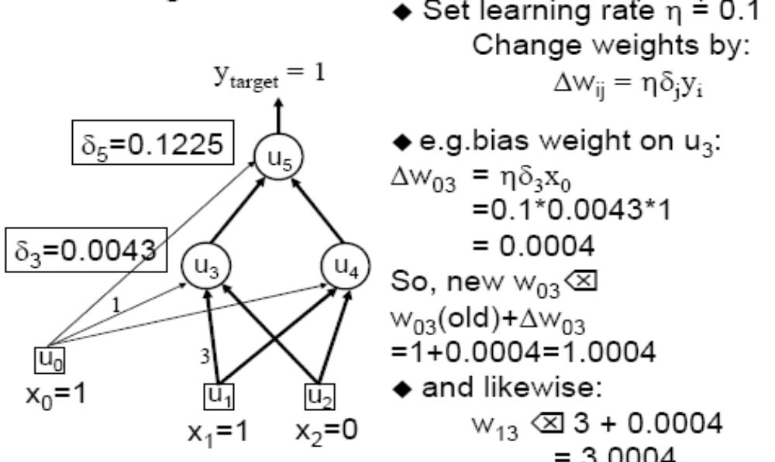
Worked example: Update Weights
Using Generalized Delta Rule (BP)

Slide 30
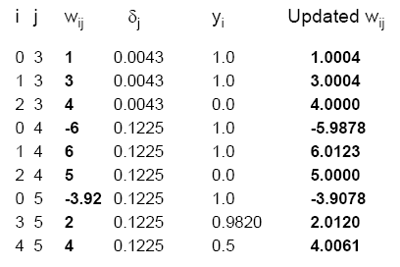
Similarly for the all weights wij:

Slide 31
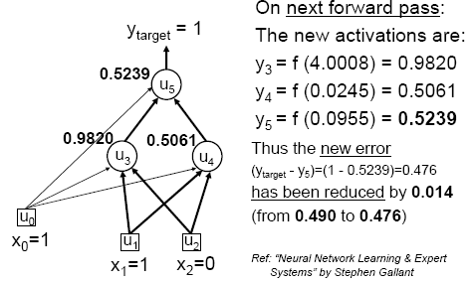
Verification that it works

Slide 32
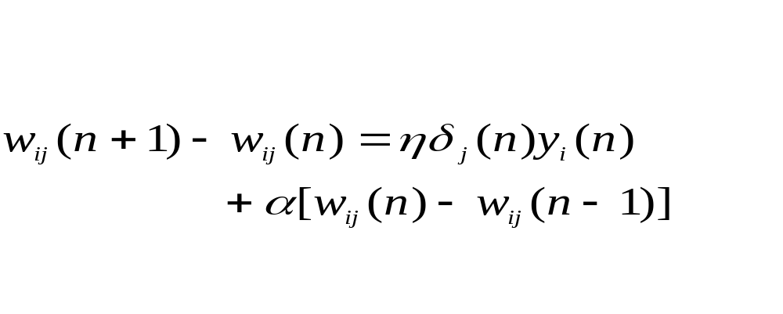
Momentum
Method of reducing problems of instability while increasing the rate
of convergence
Adding term to weight update equation term effectively exponentially holds weight history of previous weights changed
Modified weight update equation is

Slide 33
Training
This was a single iteration of back-prop
Training requires many iterations with many training examples or epochs (one epoch is entire presentation of complete training set)
It can be slow !
Note that computation in MLP is local (with respect to each neuron)
Parallel computation implementation is also possible

Slide 34
α is momentum constant and controls how much notice is taken of
recent history
Effect of momentum term
If weight changes tend to have same sign
momentum terms increases and gradient decrease
speed up convergence on shallow gradient
If weight changes tend have opposing signs
momentum term decreases and gradient descent slows to
reduce oscillations (stablizes)
Can help escape being trapped in local minima

Slide 35
Stopping criteria
Sensible stopping criteria:
  Average squared error change: Back-prop is considered to have converged when the absolute rate of change in the average squared error per epoch is sufficiently small (in the range [0.1, 0.01]).
  Generalization based criterion: After each epoch the NN is tested for generalization. If the generalization performance is adequate then stop.

Slide 36
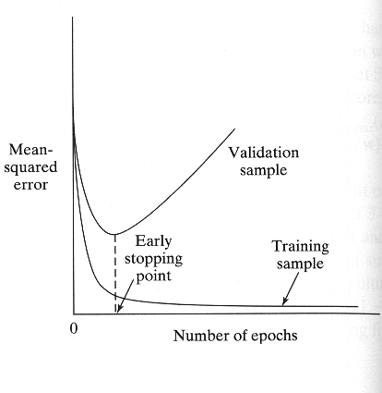
Early stopping
PMR5406 Redes Neurais e Lógica Fuzzy
Multilayer Perceptrons

Slide 37
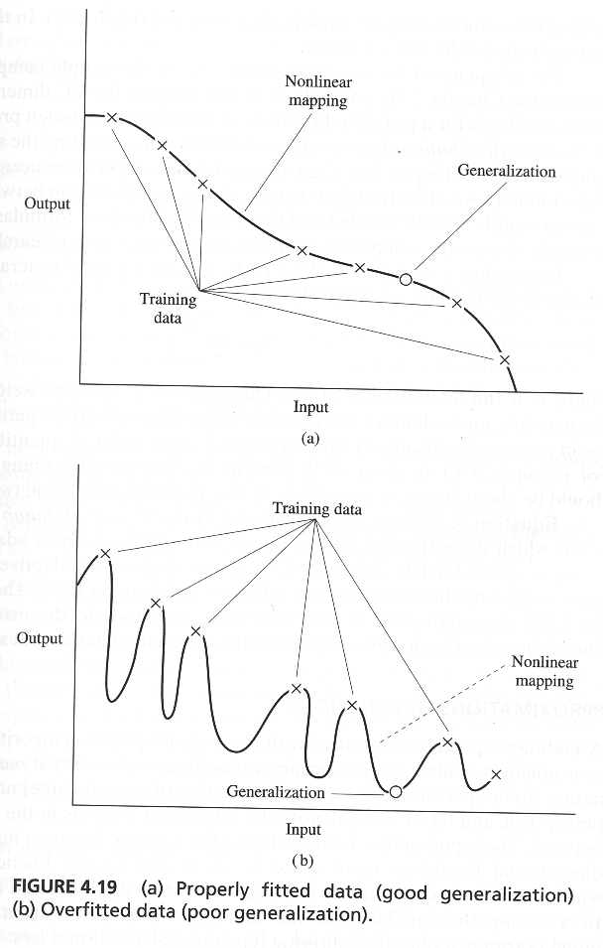
Generalization

Slide 38
GMDH
Introduced by Ivakhnenko in 1966
Group Method of Data Handling is the realization of inductive approach for mathematical modeling of complex systems.
A data-driven modeling method that approximates a given variable y (output) as a function of a set of input variables

Slide 39
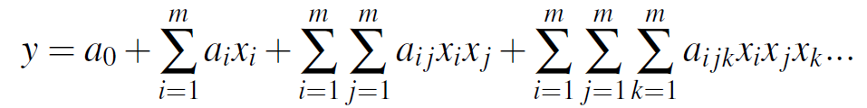
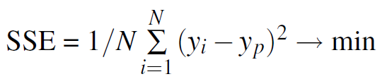
The General Form of GMDH
where X(x₁,x₂,...,x_{m}) - input variables vector; A(a₁,a₂,...,a_{m}) - vector of coefficients or weights

Slide 40
Second Order Polynomial Form
where xi and xj are input variables and y is the corresponding output value. The data points are divided into training and checking sets. The coefficients of the polynomial are found by regression on the training set and its output is then evaluated

Slide 41
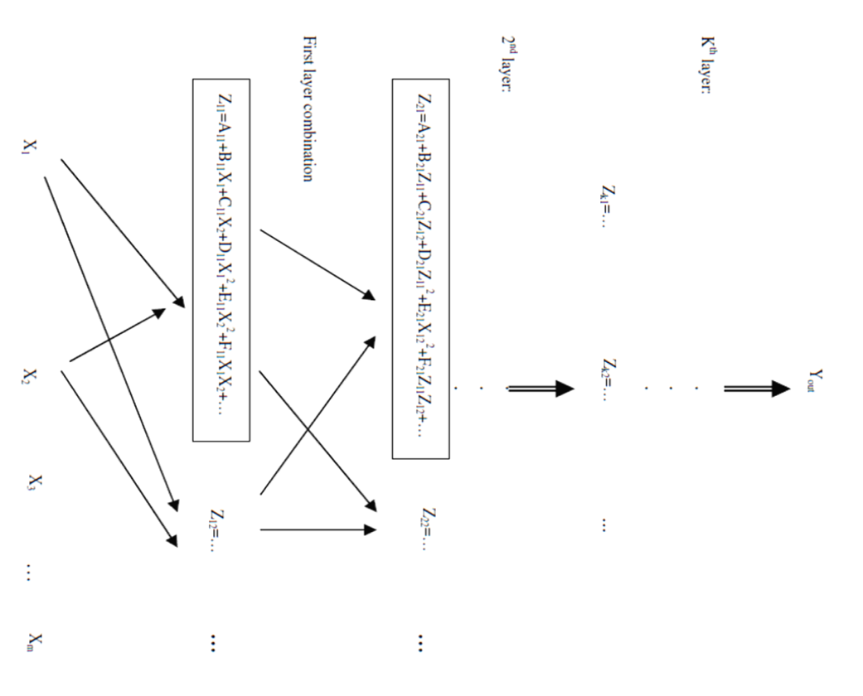
Network Structure

Slide 42
Inductive Learning Algorithm
(1) Given a learning data sample including a dependent variable y and independent variables x1, x2,... ,xm split the sample into a training set and a checking set.
(2) Feed the input data of m input variables and generate combination (w,2) units from every two variable pairs at the first layer.
(3) Estimate the weights of all units (a to/in formula (la) or (lb)) using training set. Regression method can be employed.
(4) Compute mean square error between y and prediction of each unit using checking data.
(5) Sort out the unit by mean square error and eliminate bad units.
(6) Set the prediction of units in the first layer to new input variables for the next layer, and build up a multi-layer structure by applying Steps (2) (5).
(7) When the mean square error become larger than that of the previous layer, stop adding layers and choose the minimum mean square error unit in the highest layer as the final model output.

Slide 43
Learning A Neuron
Matrix of data: inputs and desired value
    u₁, u₂ , u₃, …, u_{n} , y sample 1
    u₁, u₂ , u₃, …, u_{n} , y sample 2
    …. sample m
A pair of two u’s are neuron’s inputs x₁, x₂
m approximating equations, one for each sample
    a x₁² + b x₁ x₂ + c x₂² + d x₁ + e x₂ + f = y
Matrix X β = Y β = (a, b, c, d, e, f)^{t}
    Each row of X is x₁²+x₁x₂+x₂²+x₁+x₂+1
LMS solution β = (X^{t}X)⁻¹X^{t}Y
If X^{t}X is singular, we omit this neuron

Slide 44
GRNN
GRNN, as proposed by Donald F. Specht, falls into the category of probabilistic neural networks.
It needs only a fraction of the training samples a backpropagation neural network would need.
Its ability to converge to the underlying function of the data with only few training samples available.

Slide 45
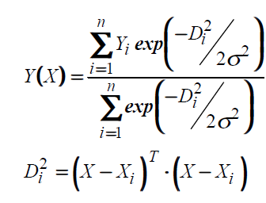
Algorithm
The calculations performed in each pattern neuron of GRNN are exp(-Dj 2/2s2), the normal distribution centered at each training sample.

Slide 46
Structures of GRNN
Input layer — There is one neuron in the input layer for each predictor variable. The input neurons then feed the values to each of the neurons in the hidden layer.
Hidden layer — This layer has one neuron for each case in the training data set. The neuron stores the values of the predictor variables for the case along with the target value. When presented with the x vector of input values from the input layer, a hidden neuron computes the Euclidean distance of the test case from the neuron’s center point and then applies the RBF kernel function using the sigma value(s). The resulting value is passed to the neurons in the pattern layer.

Slide 47
Pattern layer / Summation layer — There are only two neurons in the pattern layer. One neuron is the denominator summation unit the other is the numerator summation unit. The denominator summation unit adds up the weight values coming from each of the hidden neurons. The numerator summation unit adds up the weight values multiplied by the actual target value for each hidden neuron.
Decision layer — The decision layer divides the value accumulated in the numerator summation unit by the value in the denominator summation unit and uses the result as the predicted target value.

Slide 48
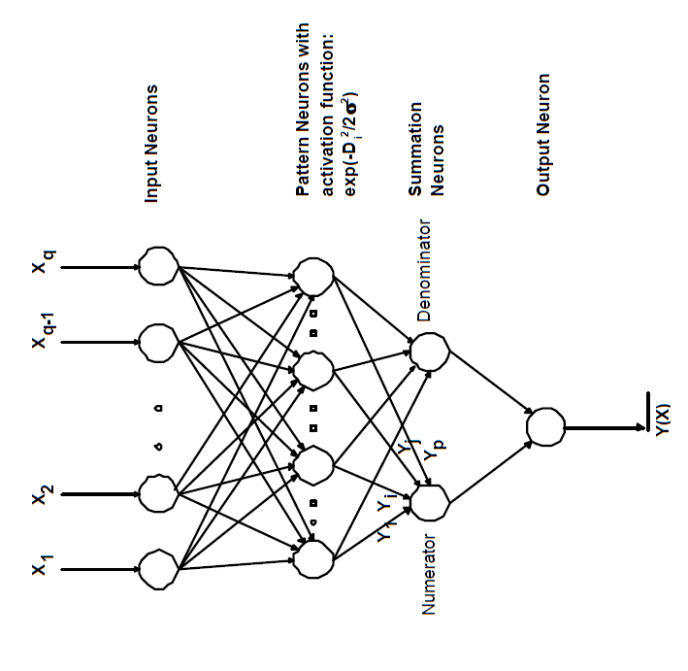

Slide 49
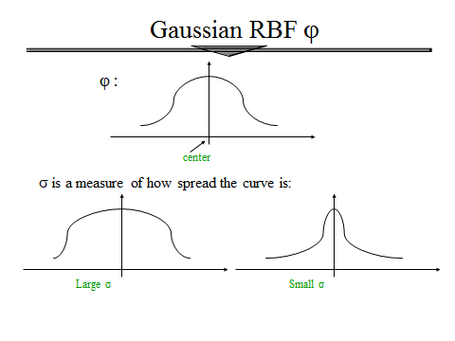
How to choose the smooth parameter

Slide 50
Advantages and Disadvantages
It is usually much faster to train a GRNN network than a multilayer perceptron network.
GRNN networks often are more accurate than multilayer perceptron networks.
GRNN networks are relatively insensitive to outliers (wild points).
GRNN networks are slower than multilayer perceptron networks at classifying new cases.
GRNN networks require more memory space to store the model.

